Slide 1

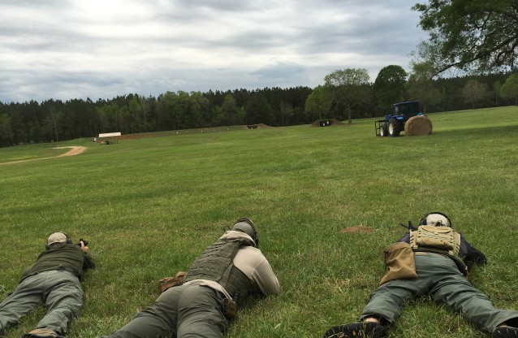
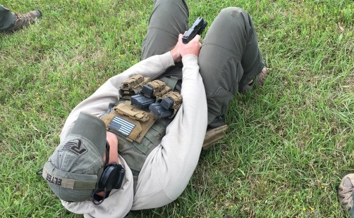
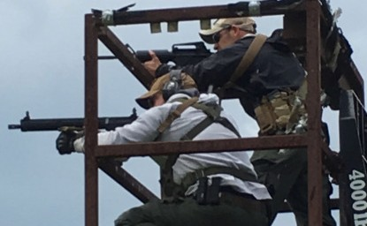
Training Division
ISO-9001 Certificate ISO-28000 Certificate

Slide 2
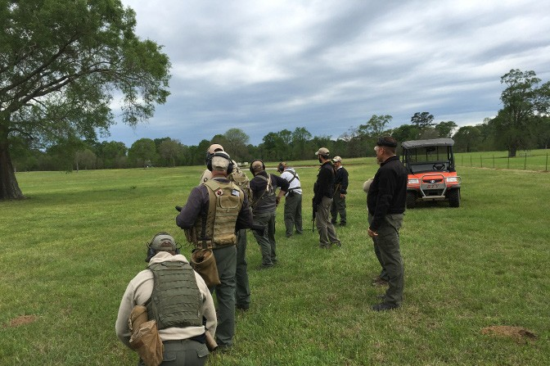
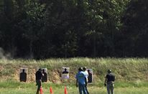

Mission
Mpromised of some of the most elite
eridian’s Training division is com-
instructors in the world. Our training
cadre is made up from Law Enforcement and Military trainers with years of experience. Meridian’s mission is to deliver professional and relevant training to every client whether they are civilian, private security, law enforcement, or military.

Slide 3
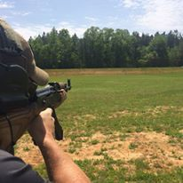
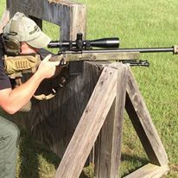
Services
When it comes to training, Meridian doesn’t believe in a one size fits all approach. Our training staff works closely with clients to create custom tailored training packages.
Meridian has a private training facility located 45 minutes north of Lake Charles, Louisiana. Our facility offers a class- room, lodging, simunition shoothouse, and three distinct firing ranges. Meridian has also partnered with training facilities to deliver training to Florida, Georgia, Alabama, Mississippi, Louisiana & Texas.
Our training services have been utilized around the world. Meridian can conduct on-site instruction for our clients.
An example being Active Shooter Training. Our staff will travel to you, carry out in-depth instruction followed by practical application using airsoft weapons to deliver the most educational and realistic training possible.

Slide 4
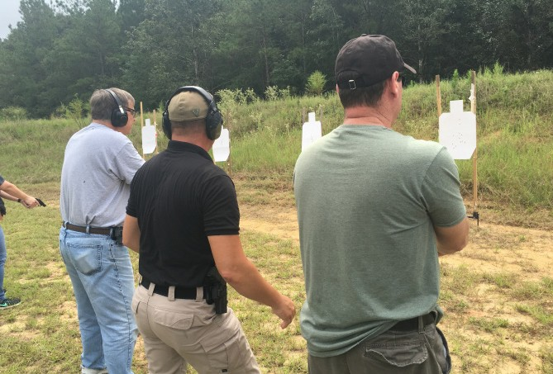
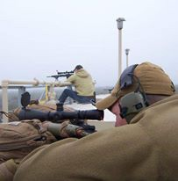
Services
Active Shooter Training Concealed Carry Courses (Louisiana) Carbine Courses (Basic/Advanced)
Emergency Response First Aid/CPR Gunsmithing/Ballistics
Handgun (Basic/Advanced) Hazmat Awareness
K9 Training
Louisiana Security Guard (Armed/Unarmed) Maritime Security Courses
Night Shoots Precision Rifle
8 Hour Church Tactical Course Tactical Combat Casualty Care (TCCC) Self Defense
Weapon Familiarization Workshops (Security/Awareness Training)

Slide 5

Contact
Gulf Coast Office
812 Downtowner Blvd. Suite A Mobile, AL 36609
Anthony Sandoval
VP of Logistics
asandoval@meridian.us Phone: (251) 345-6776
Fax: (251) 217-1040

